Slide 1

Training And Placement CELL By Roll No.04 Mr.Deep Barvekar Roll No.10 Mr.Ajay Bichukale Roll No.26 Mr.Sudarshan Gaikar Roll No.39 Mr.Rushikesh Jadhav Under The Guidance Of Ms. Prajakta Pote Department Of Computer Engineering Pillai HOC College of Engineering and Technology,Rasayani University of Mumbai, Mumbai
A.Y 2022-2023

Slide 2
Table of Content
Introduction
Literature review
Limitations of existing system
Objectives
Problem Definition
Proposed System Architecture
Implementation
Conclusion
References

Slide 3
Introduction
Introduction In today's world everyone is travelling for jobs after Completion of their graduation. It has became need for each and every student, but for that they need to travel worldwide in searching of jobs. For simplicity of this whole hectic procedures we had proposed Online Training and Placement System because of earlier system is totally data manually by maintaining records ,time consuming and very difficult to maintain coordination between student and companies.
The project is aimed at developing an online web application for the training and placement department of the college. The system is an online web application that can be accessed throughout the Institute with proper login provided. This system can be used as an application for the TPO of the college to manage the student information with regard to placement. Student logging should be able to upload their information. Organizations representatives logging in may also access/search an information put up by the students. TPO have to collect the information and manage them manually according to various streams. If any modification is required that is also to be done manually. Overall it will reduce the paper work and utilize the maximum capability of the setup and organization as well as it will save time and money.

Slide 4
Abstract
The system focuses on automation of conventional training and placement management system. This system can be used as an application for the Training & Placement Officers in the college to manage the student information with regard to placement and providing assistance using the assistance portal where students can post their query to the TPO and coordinators. Providing Student login helping them to update their personal and educational information in a form which will be added to the database and upload a resume and providing them with preparation materials for placements. An additional feature of the portal is a Company Tab which will be providing assistance to the companies to shortlist the students as per their eligibility criteria. It reduces the manual work and consumes less paperwork to reduce the time. Front end of the system is developed with the help of CSS, Bootstrap, and HTML. Backend of this system will be managed with the help of PHP. Database management of this system will be done with the help of MYSQL database.

Slide 5
Literature review
This paper is going to describe the activity related to placement, placement cell, and student databa Bse.
i) "College Collaboration Portal with Training and Placement"
Authors: Shilpa Hadkar, Snehal Baing, Trupti Hater, Sonam Wankhade, K. T. V. Reddy, and I. T. Department Padmabhushan Vasantdada Patil Pratishthan's College Of Engineering. Sion (East), Mumbai.
Abstact: The project targets documentation of student's placement activities and automation of
documentation. But lacks Event Management System's features along with report generation.
ii) "Design Paper on Online Training and Placement System (OTAP)“
Authors: Mr Nilesh T. Rathod, Prof. Enema Shah, Vidyalankar Institute of Technology Wadala, Mumbai.
Abstract The system provides considerable features of online registration, system security, automated percentage calculation, data sorting and notification services. But lacks Event Management System's features along with report generation.

Slide 6
Limitations of existing system
All processes in existing system are handled manually. All the work that is done in the existing system is done by the human intervention An all the work is done manually, there were a lot of workload on placement officer and it also increases the maximum chances of errors. This is so slow and time consuming. Due to increase in number of user's the process become more difficult. Problems faced in existing system are as follows-
• Searching of eligible students is done manually by TPO based on the company criteria.
• The records were stored in modified excel sheets hence sorting problem.
• The duplication of records was usual hence data redundancy.
• TPO's have to collect all the information and Resumes of students and organize them manually and sort them according to various streams.
• Collecting CV's of so many student is a painful and time consuming task and handling of too many CV's is a great overhead.
• It takes too much time to managing, updating and informing specific student for specific company criteria.

Slide 7
Proposed System
The main purpose of proposed Web based Training and Placement portal is meant to give more easiness to TPO, Placement coordinators and Students that they can modify and access information so quickly. The system provides a better way to maintain students information in the database, ensures data correctness and data integrity as well. The system also reduces the paperwork time and provides an efficient information flow between different system modules. Our system consists

Slide 8
Problem definition
Students choose a specific college where the placement will be held, there is a need to maintain all these papers, causing large amount of space. It is manually done, chances of missing, difficult to handle the details of student. Scope of project : Our project has a big scope to do. Students can access previous information about placement. We can stores information of all students. Various companies can access their information. Notifications are sent to students about the companies.
1 .Easy to collect and manage student data.
2. To increase the accuracy and efficiency of placement procedure.
3. Reduce the paper work.
4. Analysis of overall placement activities

Slide 9
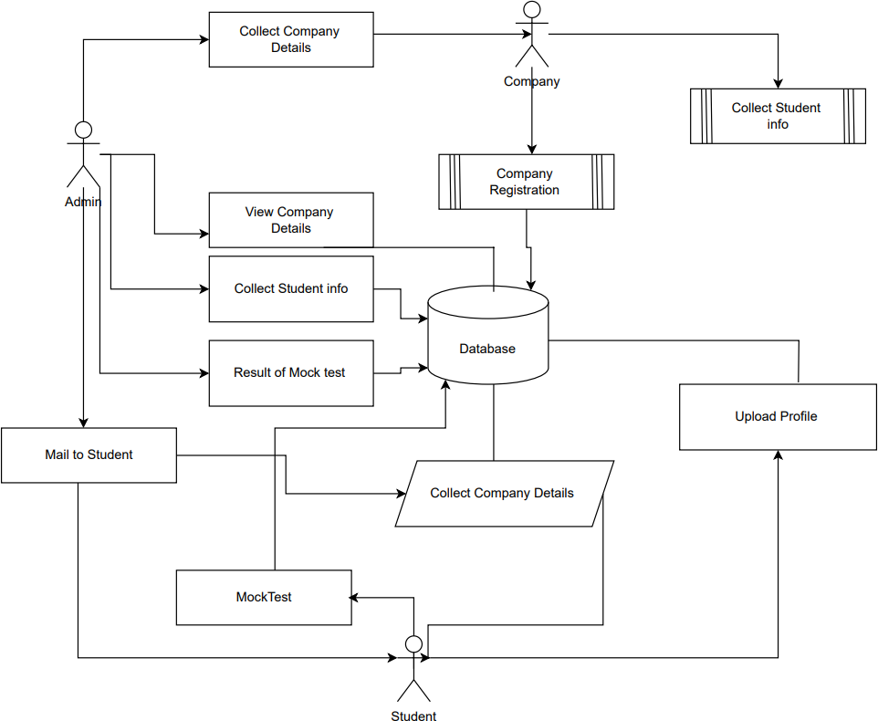
Proposed system architecture

Slide 10
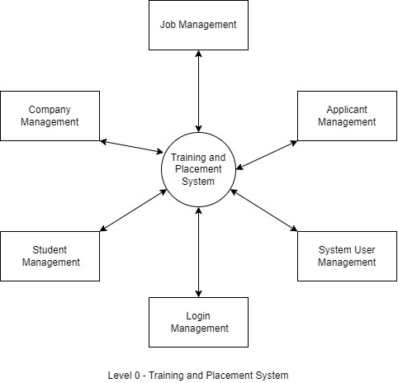
Data flow diagram level 0

Slide 11
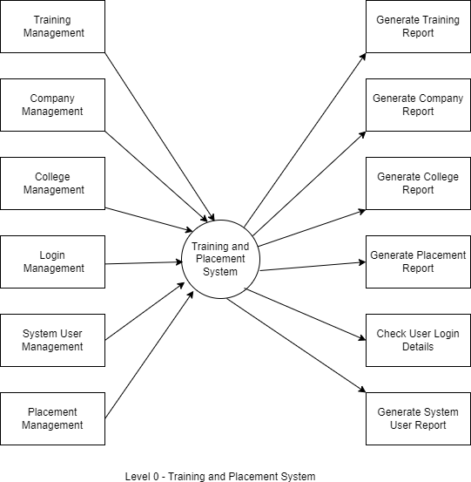
Data flow diagram level 1

Slide 12
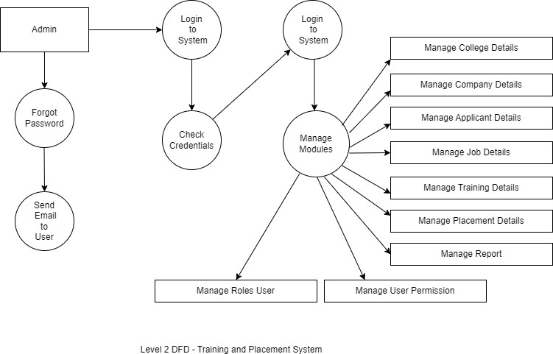
DatA FLOW DIAGRAM LEVEL 2

Slide 13
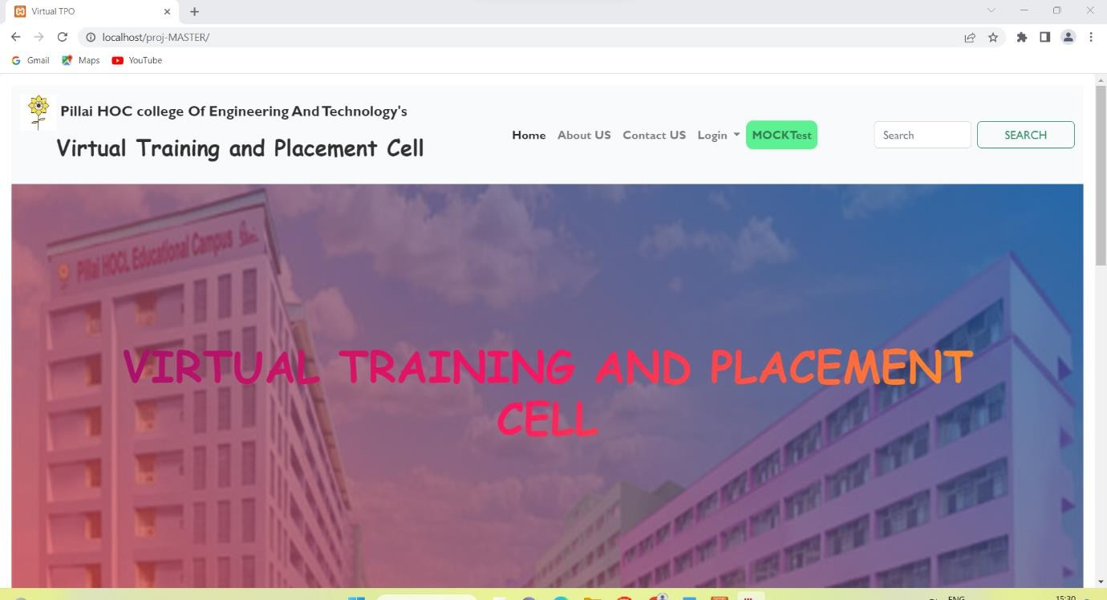
IMPLEMENTATION

Slide 14
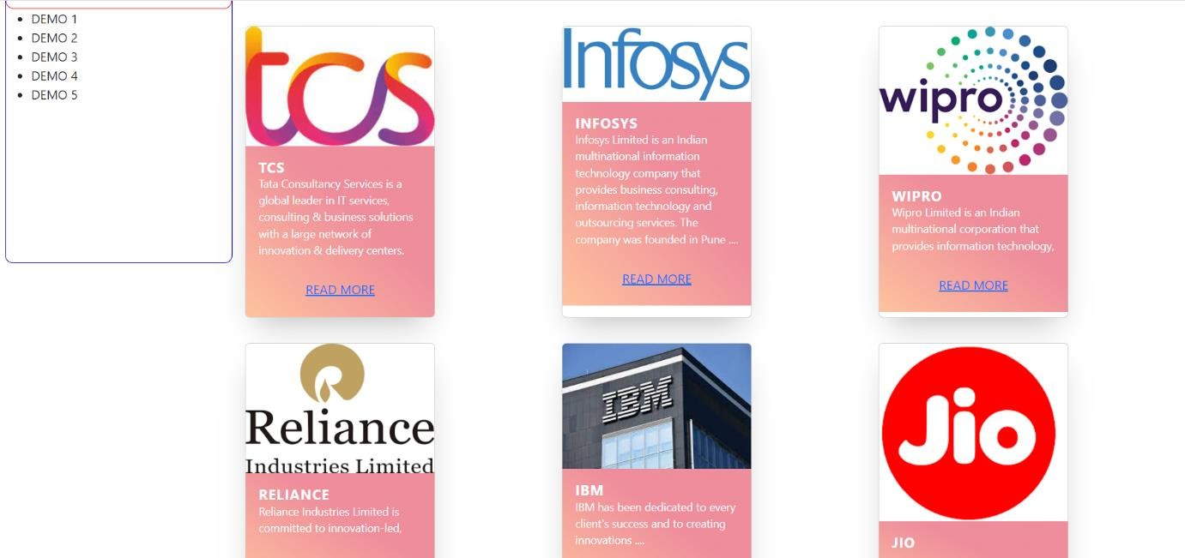

Slide 15


Slide 16
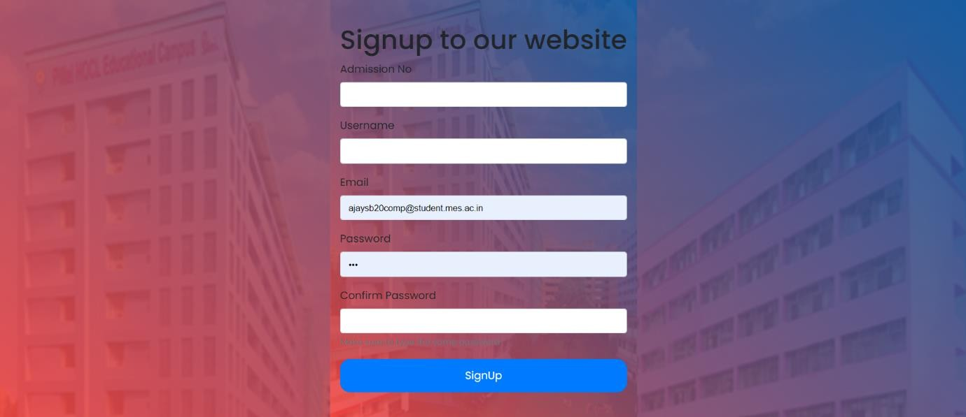

Slide 17
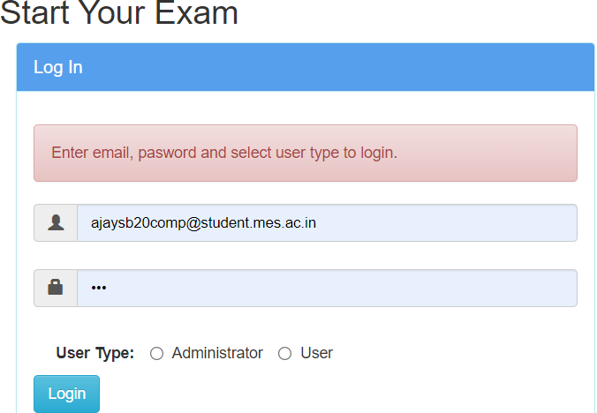

Slide 18
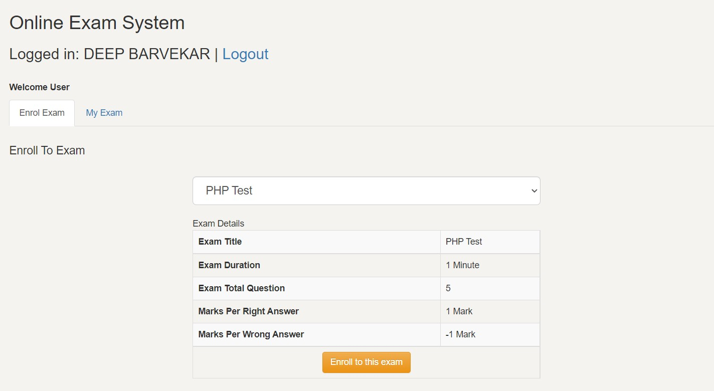

Slide 19
Conclusion
It can successfully login authorized person to system and register them. In our system admin can check the Student list those eligible according to criteria given by the Company and notify them instantly and update the information anytime successfully. Our system is Secure and User-friendly for all of three modules.
So we hope all of you can sit back and relax and enjoy the luxury of Digitalization. More so in this busy and exhausting life we are saving one of the most crucial factor that keeps us running that is human energy.

Slide 20
REfrence
1. S. Goel, R. Kiran and D. Garg, "Vulnerability Management for an Enterprise Resource Planning System", International Journal of Computer Applications, vol. 53, no. 4, pp. 19-22, 2012
2. H. Siirtola, K. J. Raiha and V. Surakka, "Interactive Curriculum Visualization", 2013 17th International Conference on Information Visualisation, pp. 1-3, 2013
3. M. Raji, J. Duggan, B. DeCotes, J. Huang and B. V. Zanden, "Visual Progression Analysis of Student Records Data", 2017 IEEE Visualization in Data Science (VDS), pp. 2-5, 2017 20

